Slide 1
JavaScript Basics

Slide 2
Contents
INTRODUCTION
What JS cant do?
Why JS?
What JS can do?
History
JS Syntax

Slide 3
Introduction
JavaScript is the programming language of HTML and the Web.
JavaScript is one of the 3 languages all web developers must learn:
HTML to define the content of web pages
CSS to specify the layout of web pages
JavaScript to program the behavior of web pages
Web pages are not the only place where JavaScript is used. Many desktop and server programs use JavaScript. Node.js is the best known. Some databases, like MongoDB and CouchDB, also use JavaScript as their programming language

Slide 4
Introduction Contd.
JavaScript is an interpreted programming language with object- oriented (OO) capabilities.
JavaScript is a scripting language you can use — in conjunction with HTML — to create interactive Web pages.
A scripting language is a programming language that’s designed to give folks easy access to prebuilt components.
In the case of JavaScript, those prebuilt components are the building blocks that make up a Web page (links, images, HTML form elements, browser configuration details, and so on).
Syntactically, the core JavaScript language resembles C, C++, and Java, with programming constructs such as the if statement, the while loop, and the && operator.
JavaScript is a loosely typed language, which means that variables do not need to have a type specified.
It is commonly called client-side JavaScript to emphasize that scripts are run by the client computer rather than the web server.

Slide 5
What JS cant do?
JavaScript is simply a scripting language.
Cannot write a desktop application
JavaScript is limited
Cannot access local files directly
Cannot directly access database
Cannot access hardware (As Usb, etc)

Slide 6
Why JS?
JavaScript was designed to manipulate webpages
A Programming Language, Behavior and Interactivity with the page.
What happens when you move mouse over menu.
What happens when a user types in an invalid or wrong value in textfield.
How Long a photo Slide Show takes to move from one image to other.
ANSWER IS JAVASCRIPT!

Slide 7
WHAT JAVASCRIPT CAN DO?
JavaScript gives HTML designers a programming tool
JavaScript can put dynamic text into an HTML page
JavaScript can react to events
JavaScript can read and write HTML elements
JavaScript can be used to validate input data
JavaScript can be used to detect the visitor's browser
JavaScript can be used to create cookies

Slide 8
Contd.
JavaScript can change all the HTML elements in the page
JavaScript can change all the HTML attributes in the page
JavaScript can change all the CSS styles in the page
JavaScript can remove existing HTML elements and attributes
JavaScript can add new HTML elements and attributes
JavaScript can react to all existing HTML events in the page
JavaScript can create new HTML events in the page

Slide 9
History
JavaScript was originally developed by Brendan Eich of Netscape under the name Mocha.
Later renamed to LiveScript.
Finally to JavaScript mainly because it was more influenced by the Java programming language.
JavaScript very quickly gained widespread success as a client-side scripting language for web pages.
As a consequence, Microsoft named its implementation JScript to avoid trademark issues. (JScript is Microsoft's dialect of the ECMAScript standard that is used in Microsoft's Internet Explorer.)
JScript was included in Internet Explorer 3.0, released in August 1996.

Slide 10
WHAT NEEDED TO WRITE A JAVASCRIPT
It Doesn't matter it be
Pc
Mac,
Linux
What ever language it be,
Php
ruby on rails
Asp.net
No Licensing is need.
Basically will work on a simple Text Editor.

Slide 11
HOW AND WHERE TO PLACE JAVASCRIPT
JavaScript consists of JavaScript statements that are placed within the <script>... </script> HTML tags in a web page.
The <script> tag alert the browser program to begin interpreting all the text between these tags as a script.
The script tag takes two important attributes:
language:
This attribute specifies what scripting language you are using. Typically, its value will be “javascript”.
type:
This attribute is what is now recommended to indicate the scripting language in use. Its value should be set to "text/javascript".
<script language="javascript" type="text/javascript">
JavaScript code
</script>

Slide 12
Contd.
You Can place Script tag in
head section: The browser interprets from top to bottom and head section is read first than the body. So will do some javascript work and then will show up content of body
body section:
Start: It will execute right after head.
Middle: It will in middle of code
End: Right at the end.
It depends on condition that you want a page to do processing before the content is rendered. Creating some dynamic content, then should do in Head Section.
There arise a need to process some elements in body then go ahead writing to body. Beware when code increases.
It could be the case you may load external javascript code as in css.

Slide 13
Example Code
<html>
<head>
<script> alert("head") </script>
</head>
<body>
<script> alert("start"); </script>
<p>This is text</p>
<p>some what in middle 1</p>
<p>some what in middle 2</p>
<script> alert("middle"); </script>
<p>some what in middle 3</p>
<p>some what in middle 4</p>
<p>finally end</p>
<script>alert("end");</script>
</body>
</html>

Slide 14
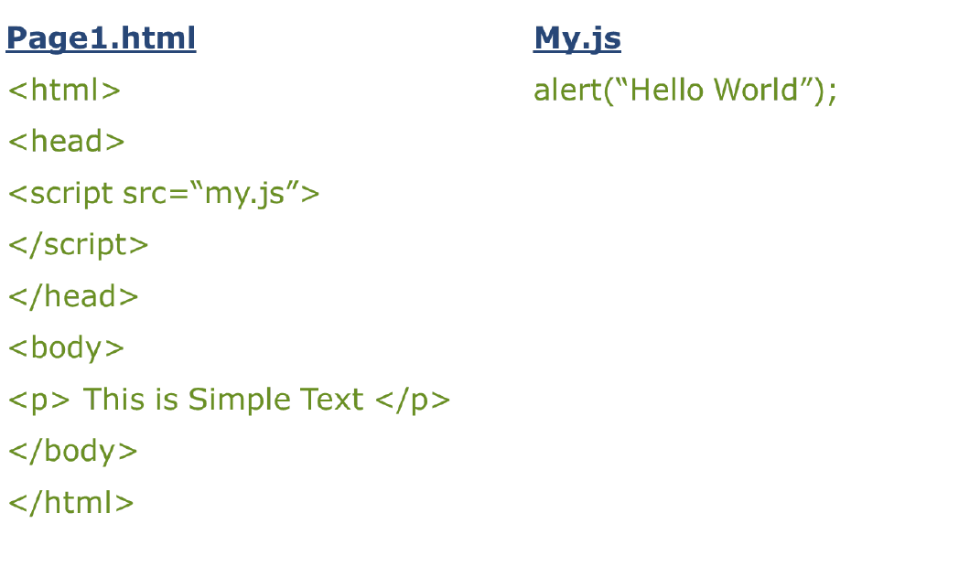
REFERENCING AN EXTERNAL FILE

Slide 15
WHITESPACE AND LINE BREAKS
JavaScript ignores
spaces
tabs
newlines
So, you can use spaces, tabs, and newlines freely in your programs, you are free to format and indent your programs in a neat and consistent way that makes the code easy to read and understand.

Slide 16
OPTIONAL SEMILCOLONS
Simple statements in JavaScript are generally followed by semicolons (;), just as they are in C, C++, and Java.
The semicolon serves to separate statements from each other.
In JavaScript, however, you may omit the semicolon if each of your statements is placed on a separate line.
<script language="javascript" type="text/javascript">
statement1
statement2
</script>

Slide 17
CASE SENSITIVITY
JavaScript is a case-sensitive language.
This means that
language keywords
variables
function names
must always be typed with a consistent capitalization of letters.
So identifiers Test, TeSt and TEST will have different meanings in JavaScript.
Proper Care should be taken while writing your variable and function names in JavaScript.

Slide 18
COMMENTS IN JAVASCRIPT
JavaScript supports both C-style and C++ style comments
Any text between a // and the end of a line is treated as a comment and is ignored by JavaScript.
Any text between the characters /* and */ is treated as a comment. This may span multiple lines.
JavaScript also recognizes the HTML comment opening sequence
<!-- JavaScript treats
This as a single-line comment, just as it does the // comment.
The HTML comment closing sequence --> is not recognized by JavaScript so it should be written as //-->.

Slide 19
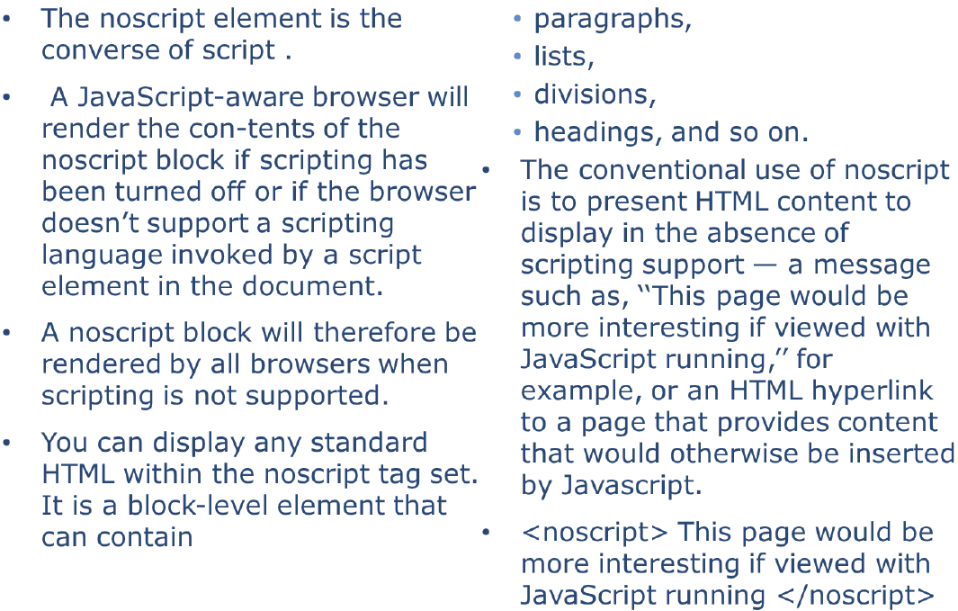
NO SCRIPT TAG

Slide 20
Contd.
<!DOCTYPE html>
<html>
<body>
<script> document.write("Hello World!") </script>
<noscript>Sorry, your browser does not support JavaScript!</noscript>
<p>A browser without support for JavaScript will show the text inside the noscript element.</p>
</body>
</html>

Slide 21
VARIABLES
In all programs we need to keep track of all kinds of data as email, date of birth and etc.
We create variables for the above purpose.
Variable is a container grabbing a piece of memory and giving it a name so we can use it in javascript.
We create variable with the word var. For example:
var value;
var name;
var x, y; // How to declare variables x = 5; y = 6; // How to assign values z = x + y; // How to compute values
Notes:
Var decides at run time

Slide 22
JAVASCRIPT VARIABLE SCOPE
The scope of a variable is the region of your program in which it is defined. JavaScript variable will have only two scopes.
Global Variables:
A global variable has global scope which means it is defined everywhere in your JavaScript code.
Local Variables
A local variable will be visible only within a function where it is defined. Function parameters are always local to that function.

Slide 23
JAVASCRIPT VARIABLE NAMES
While naming your variables in JavaScript keep following rules
You should not use any of the JavaScript reserved keyword as variable name.
For example, break or boolean variable names are not valid.
JavaScript variable names should not start with a numeral (0-9). They must begin with A letter or the underscore character.
For example, 123test is an invalid variable name but _123test is a valid one.
JavaScript variable names are case sensitive.
For example, Name and name are two different variables.

Slide 24
JAVASCRIPT DATATYPES
One of the most fundamental characteristics of a programming language is the set of data types it supports.
JavaScript allows you to work with three primitive data types:
Numbers eg. 123, 120.50 etc. (Number can be written with or without decimals)
Strings of text e.g. "This text string" etc. (Strings can be written with double or single quotes)
"John" + " " + "Doe“ (allows)
Boolean e.g. true or false.
JavaScript also defines two trivial data types, null and undefined, each of which defines only a single value.
In addition to these primitive data types, JavaScript supports a composite data type known as object.
Notes:
Object is for unified type system (where value of any type can ultimately be treated as an object)

Slide 25
Contd.
var length = 16; // Number var lastName = "Johnson"; // String var x = {firstName:"John", lastName:"Doe"}; // Object
var x = 16 + "Volvo"; converted into var x = "16" + "Volvo";
When adding a number and a string, JavaScript will treat the number as a string.
JavaScript evaluates expressions from left to right. Different sequences can produce different results:
var x = 16 + 4 + "Volvo"; Result: 20Volvo
var x = "Volvo" + 16 + 4; Result: Volvo164

Slide 26
Operators
Using expression 4 + 5 is equal to 9.
Here 4 and 5 are called operands and + is called operator.
JavaScript language supports following type of operators.
Arithmetic Operators (+, -, *, /, %, ++, --)
Comparison Operators (==, !=, >, <, >=, <=)
Logical (or Relational) Operators (&&, ||, !)
Assignment Operators (=, +=, -=, *=, /=, %=)
Conditional (or ternary) Operators (?:)
If Condition is true ? Then value X : Otherwise value Y

Slide 27
More..
Conditional Statements
if statement
if...else statement
if...else if... Statement
Switch
Loops
while
do/while
for
for/in.
Notes:
switch (expression)
{
case condition 1: statement(s) break;
case condition 2: statement(s) break;
...
case condition n: statement(s) break;
default: statement(s)
}
var person = {fname:"John", lname:"Doe", age:25}; var text = ""; var x; for (x in person) { text += person[x] + " "; }

